Slide 1
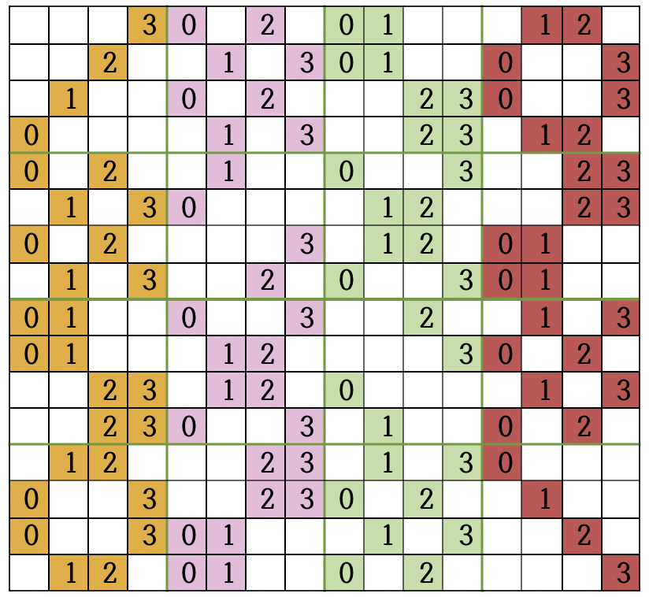
DTLS supporting Crypto Chip(Optimized algorithm)
Haeyoung Kim, Janghyun Ji, Jinjae Lee, Howon Kim
Department of Electrical Electronic Computer Engineering, Pusan National University
E-mail : ryoung0327@gmail.com, jjh0819@gmail.com, wlswo3149@gmail.com, howonkim@gmail.com
In developing SoC security module that strengthens the security of vulnerable IoT equipment without replacing the basic equipment, it is necessary to improve the speed and area. Basically, IoT devices are small, so the smaller the SoC security module, the better. In addition, IoT requires real-time data processing, so the data processing speed of the SoC security module must also be fast.
Cryptographic Chip
Plaintext
Aria_op
key
SPI, UART
ARIA Module
CU
Key_op
Last
Number
of Round
Key_size
Key
Status
Interrupt
Data Buffer
Interface
Diff_op
Subs_op
Flg_LT
Dispatcher
Substitution
Round_key
Add Round Key
Slave
Master
Slave
Diffusion
AXI
Slave
Slave
Slave
Slave
Ciphertext
ARIA
GHASH
HASH
ECC
<Architecture of ARIA module>
This ARIA module supports 128bit and 256bit block ciphers. All internal modules are operated by the Control Unit. The Substitution Module replaces 32bit data with 128bit data for a total of 4 rounds. In the diffusion module, the pipeline works with the substitution module and Diffusion by 32bits in each rounds.
<Architecture of Cryptographic Chip>
The cryptographic Core of the SoC security chip is the part that actually encrypts data. SoC security chip is trying to minimize the area by using registers without memory. Dispatcher is used to create CSRs and analyze commands. Dispatcher manages multiple slaves with one master and multiple slave structure. It enables that fast communication through AXI protocol using multiple channels.
y0
3
2
1
0
y1
y2
y3
1
y4
2
3
0
y5
0
1
2
3
y6
=
y7
1
0
3
2
1
0
y8
ARIA Module
3
2
y9
2
3
0
1
y10
y11
3
2
1
0
y12
AXI Slave Wrapper
0
1
2
3
y13
ARIA module
y14
CSRs
ARIA Core
0
1
2
3
<16 byte Diffusion Module>
y15
CSRs
ARIA
MOO
Since the hard-coding method of the diffusion stage occupies a lot of area, we search for rules to reduce the area and decompose it into 4 rounds. It can be made of 13 Xor gates and 3 Mux. For hard-coding methods, 112 Xor gates are required but we only use 13 Xor gates.
…
CSRs
<Architecture of ARIA Module>
Results
ARIA module is consists of CSRs(Control and Status Registers) module for command analysis and ARIA MOO(Mode Of Operation). ARIA MOO consists of ARIA core for block cipher and mode for block cipher. Block cryptography mode supports ECB, CBC, CTR and GCM.
Scenario | Total Area | Circuit size
100 mhz | 4083720 ${mm}^{2}$ | 409 kGE
After synthesis, we got 4083720 ${mm}^{2}$ total Area size and 409 kGE circuit size.
The design process is digital, Magnachip Semiconductor / SK Hynix 180nm process, the supply voltage is 3.3V, and the maximum operating frequency is 100MHz. We have verified the interlocking and operation of each encryption module and confirmed that data can be encrypted and authenticated using the developed SoC security module. In this version, we focused on optimizing the area, but in the next version we will optimize the area and speed.
본 연구는 IDEC에서 MPW를 지원받아 수행하였습니다.

